Slide 1
CSCNSI 2015
Operating System Installation

Slide 2
Introduction
Criteria
Installation
Configuration

Slide 3
Criteria

Slide 4
Criteria
Stability
Frequency of Updates
Hardware Support
Customization
Ease of Maintenance

Slide 5
Criteria
Heavyweight (CentOS; Debian)
Meant to be turn-key easy
Designed to have everything
Lightweight (Arch; Gentoo; OpenBSD)
Not easy for beginners
Start with minimal install

Slide 6

CentOS
Instruction will revolve around CentOS version 6
Supports our equipment
Very stable
Derived from RHEL
RHEL is popular at the Lab

Slide 7







Other Distributions
Feel free to choose another distribution
Equipment support might be lacking
Completely “on your own” for OS specific issues

Slide 8
Installation

Slide 9
Installation
The Big Picture
Install head node from CD (or network)
Copy files from CD (or network) to head node
Publish files via web server (as repository)
Setup network booting environment
Boot compute nodes via network
Install OS on compute nodes via repository

Slide 10
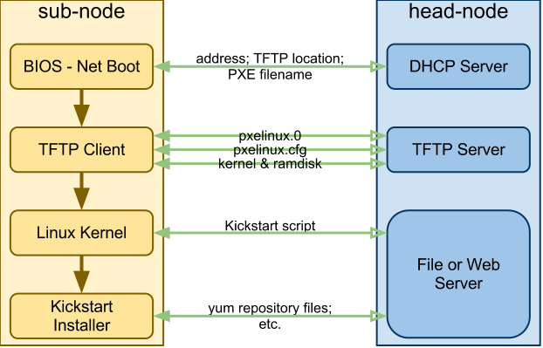
Installation - The Big Picture

Slide 11
Installation
System Disk Partitions
Compartmentalize for security and stability
DoS attack by filling system drive
partition encryption (i.e. /home)
Easier backup/recovery
Plan your partitions and stick to the plan!

Slide 12
System Disk Partitions
/ | root filesystem (default)
swap | memory swap (default)
/usr; /usr/local | user executables; kernel source; docs
/var | spool; caches; system logs
/tmp | temporary
/boot | kernel; bootloader
/home | user home directories
/opt | locally compiled executables; configs; docs

Slide 13
System Disk Partitions
/ | > 4GB
swap | > 2 x (RAM size)
/usr | > 4GB
/var | > 1GB
/tmp | > 2GB
/boot | > 100MB (typ. 500MB)
/home | > (user count) x (allotment)
/opt | > 4GB on a real system < 500MB on ours

Slide 14
System Disk Partitions Recommendations
swap | > 2 x (RAM size) w/ max of 16GB
boot | > 500MB
/ | fill remaining space ('grow')

Slide 15
Installation
What to Install
If users can log into it, make sure it has everything they expect
Keep in mind the type of system you’re building
Plan it out before implementation
Document everything

Slide 16
Installation
What to Install
Setup your BIOS for booting from network
Repos exist on my machine at
http://cscnsi.newmexicoconsortium.org/repo/
rsync://cscnsi.newmexicoconsortium.org/repo/
Install: CentOS 6.5 x86_64

Slide 17
Configuration

Slide 18
Minimal Configuration
This discussion will be a minimal configuration to get things running. Later we’ll talk about:
Networking
Security
System and Network Services
Cluster deployment and monitoring

Slide 19

Security-Enhanced Linux (SELinux)
Access control security
You will run into problems that are hard to identify
It can get quite complicated
For this summer institute: just turn it off
# setenforce 0
# sed -i "s/^SELINUX=enforcing$/SELINUX=disabled/" \
/etc/selinux/config

Slide 20
Enable Networking
Configure the network:
# cat /etc/sysconfig/network-scripts/ifcfg-eth0
DEVICE=eth0
ONBOOT=yes
BOOTPROTO=dhcp
Turn on the network:
# ifup eth0

Slide 21
Configure SSH
Configuration file: /etc/ssh/sshd_config
Do not allow root login
Do not allow password authentication
Public-key authentication
One time password (OTP) authentication (optional)

Slide 22
Summary

Slide 23
Summary
Criteria
Installation
Configuration

